Slide 1

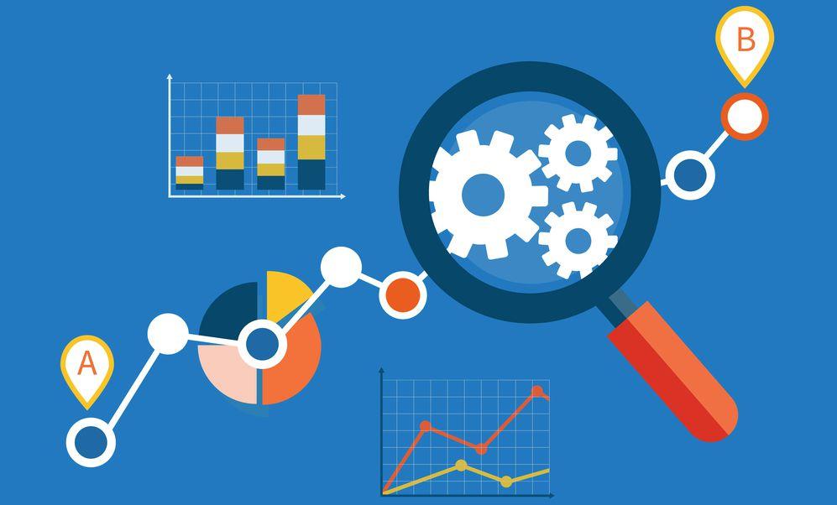

SQL PROJECT: MUSIC STORE DATA ANALYSIS

Slide 2

OBJECTIVE:
Analyze an online music store's data using SQL to derive insights into customer behaviours, product popularity, and sales trends, ultimately improving decision-making and optimizing the platform's performance.
DATABASE AND TOOLS
Postgre SQL
PgAdmin4

Slide 3

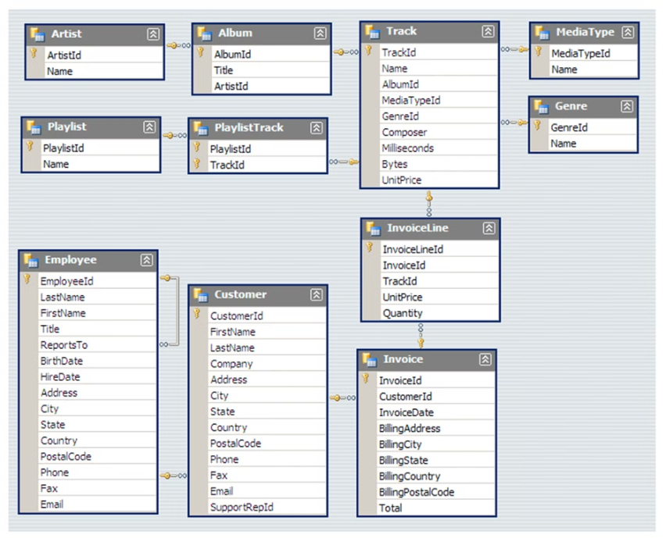
SCHEMA- MUSIC STORE DATABASE

Slide 4
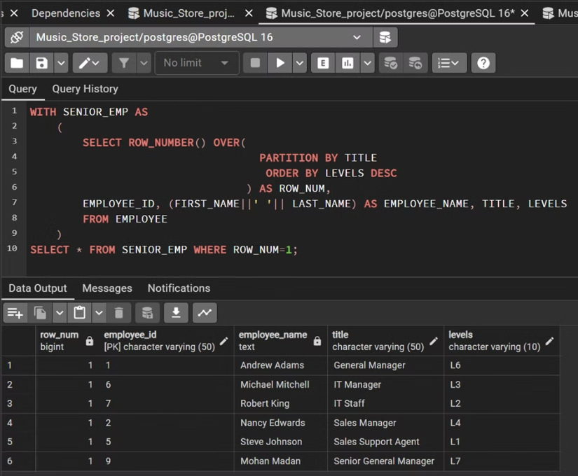
Question Set 1
Q1. Who is the senior most employee based on job title?

Slide 5
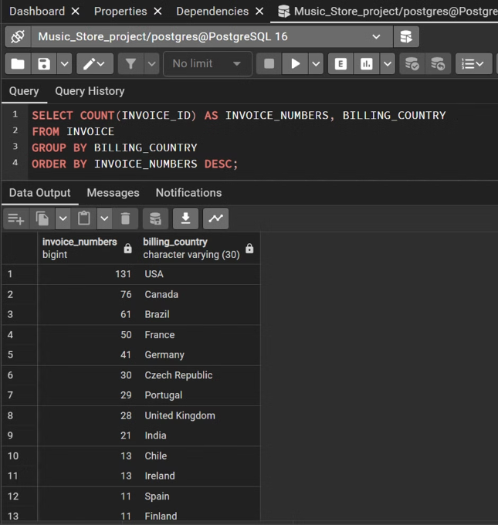
Q2. Which countries have the most invoices?

Slide 6
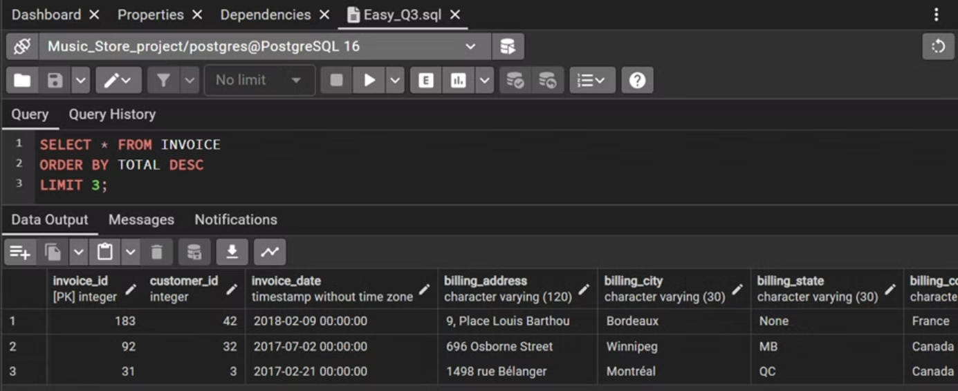
Q3. What are top 3 values of total invoice?

Slide 7
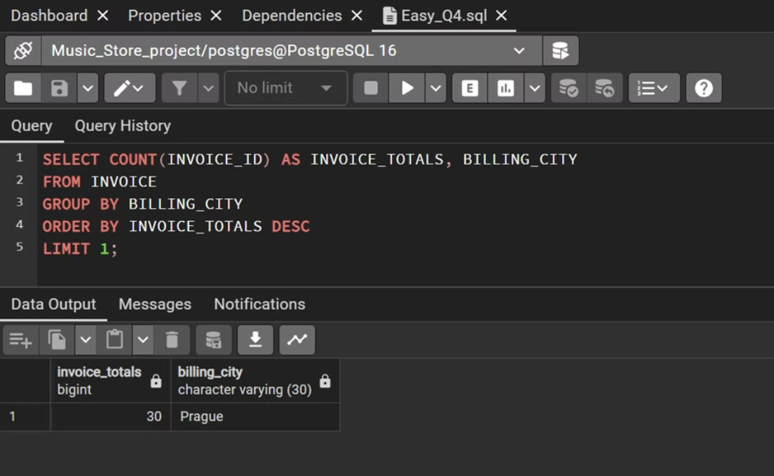
Q4. Which city has the best customers? We would like to throw a promotional Music Festival in the city we made the most money. Write a query that returns one city that has the highest sum of invoice totals. Return both the city name & sum of all invoice totals.

Slide 8
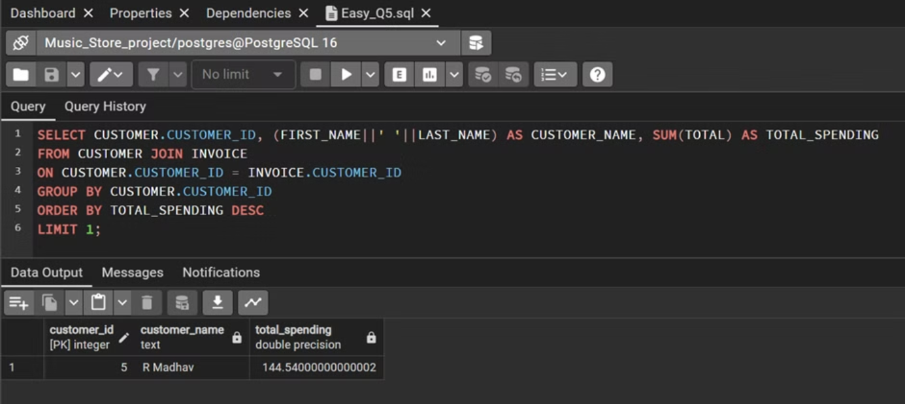
Q5. Who is the best customer? The customer who has spent the most money will be declared the best customer. Write a query that returns the person who has spent the most money.

Slide 9

QUESTION SET 1 :KEY LEARNINGS
Utilizing the ROW_NUMBER() function with PARTITION BY and ORDER BY for finding the senior most employee based on job title.
Aggregating data using COUNT() and GROUP BY to identify countries with the most invoices.
Basic use of ORDER BY and LIMIT for retrieving top values from a table.
Grouping and ordering data to find the city with the highest sum of invoice totals.
Joining tables and using SUM() to determine the customer who has spent the most money.

Slide 10
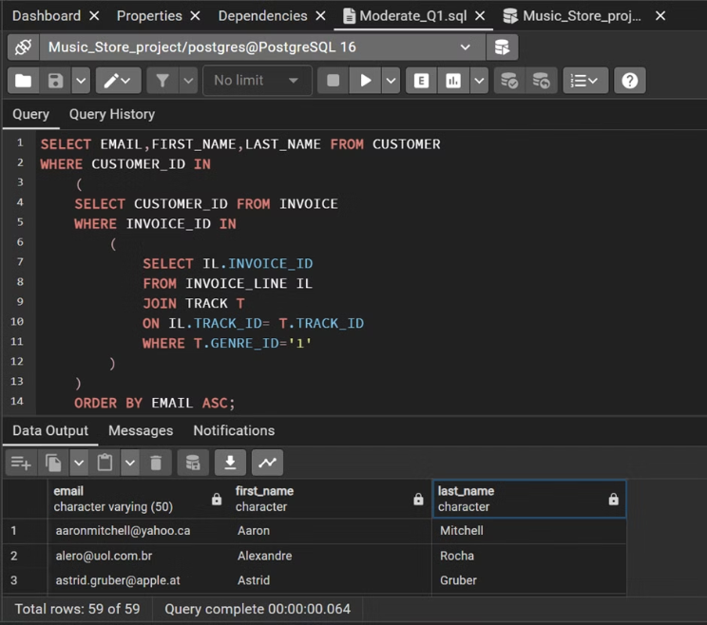
Question Set 2
Q1. Write query to return the email, first name, last name, & Genre of all Rock Music listeners. Return your list ordered alphabetically by email starting with A.

Slide 11
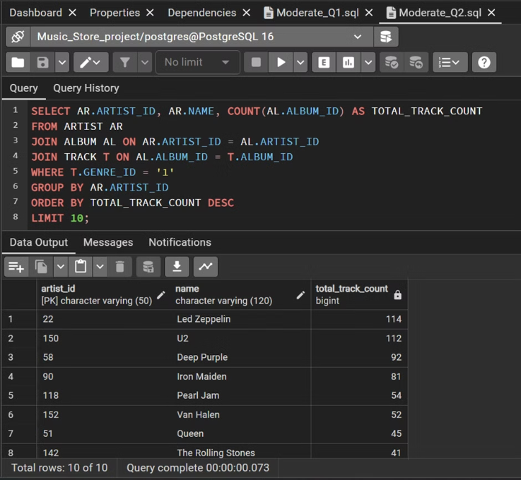
Q2. Let's invite the artists who have written the most rock music in our dataset. Write a query that returns the Artist name and total track count of the top 10 rock bands.

Slide 12
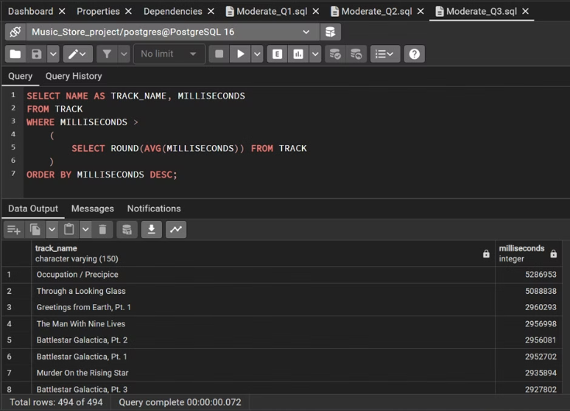
Q3. Return all the track names that have a song length longer than the average song length. Return the name and Milliseconds for each track. Order by the song length, with the longest songs listed first.

Slide 13
QUESTION SET 2 :KEY LEARNINGS
Nesting queries to find email, first name, and last name of customers who have purchased Rock music.
Joining multiple tables and using COUNT() and GROUP BY to identify top rock bands.
Utilizing a subquery with AVG() to filter tracks with a song length longer than the average.

Slide 14
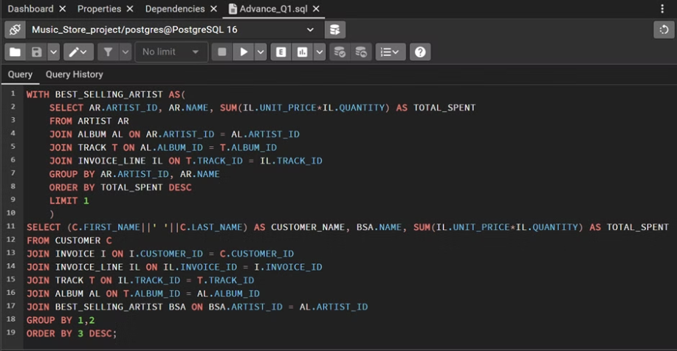
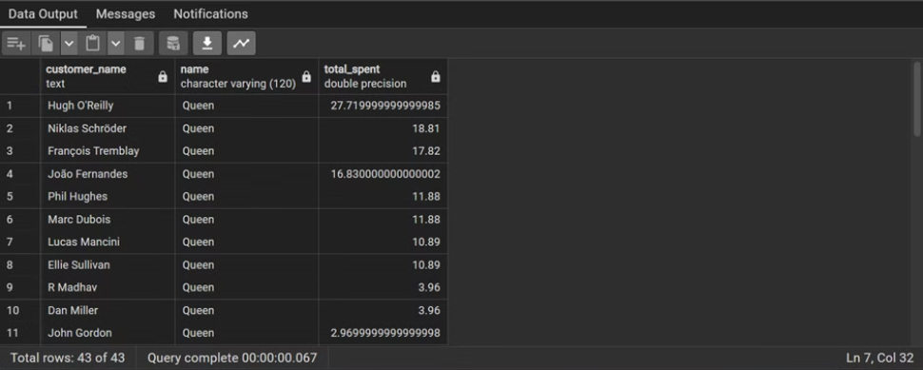
Question Set 3
Q1. Find how much amount spent by each customer on artists? Write a query to return customer name, artist name and total spent.

Slide 15
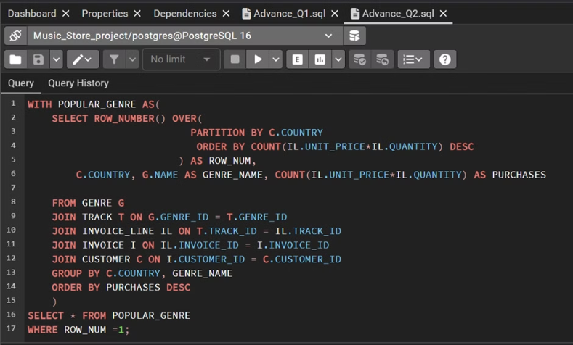
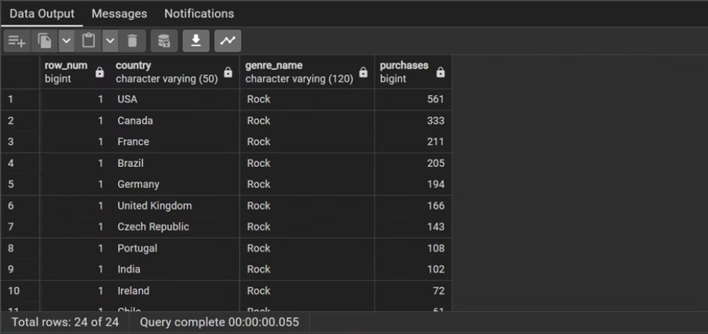
Q2. We want to find out the most popular music Genre for each country. We determine the most popular genre as the genre with the highest amount of purchases.Write a query that returns each country along with the top Genre. For countries where the maximum number of purchases is shared return all Genres.

Slide 16
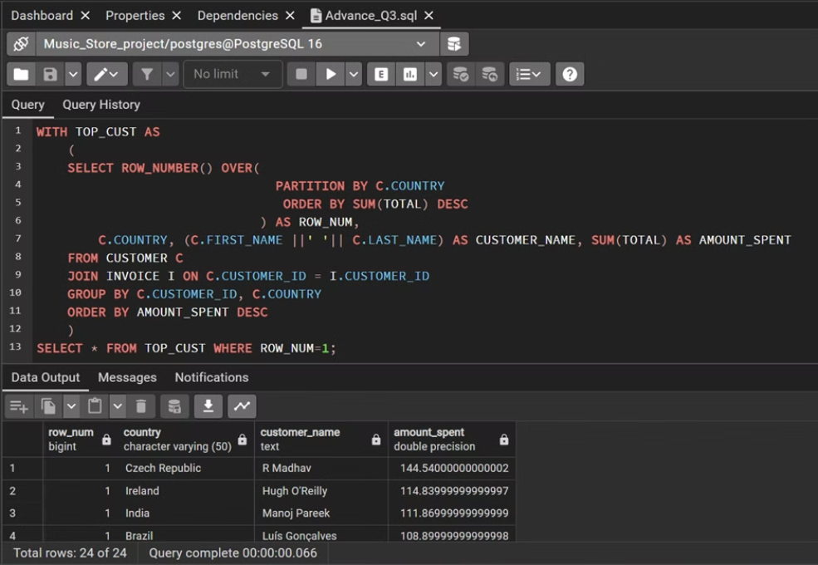
Q3. Write a query that determines the customer that has spent the most on music for each country. Write a query that returns the country along with the top customer and how much they spent. For countries where the top amount spent is shared, provide all customers who spent this amount.

Slide 17
QUESTION SET 3 :KEY LEARNINGS
Using Common Table Expressions (CTE) to create temporary result sets for complex queries.
Combining CTEs, joins, and aggregation to find the amount spent by each customer on the best-selling artist.
Employing window functions and PARTITION BY to determine the most popular music genre for each country..
Developing a query to identify the top-spending customer for each country, handling ties when multiple customers spend the same amount.

Slide 18
OVERALL LEARNINGS
Mastery of basic SQL functions (SELECT, JOIN, WHERE, ORDER BY, GROUP BY, etc.).
Understanding and applying window functions for advanced analytics (ROW_NUMBER() over PARTITION BY).
Efficient use of subqueries and common table expressions (CTEs) for modular and readable SQL code.
Aggregation techniques for summarizing and analyzing data (SUM, COUNT).
Handling ties and ranking with ROW_NUMBER() for scenarios where multiple entities share the same attribute.
Integration of logical conditions and filters to retrieve specific subsets of data.
Application of SQL for business analysis, decision-making, and strategic planning in a music store context.

